Slide 1
Circularly Linked List

Slide 2
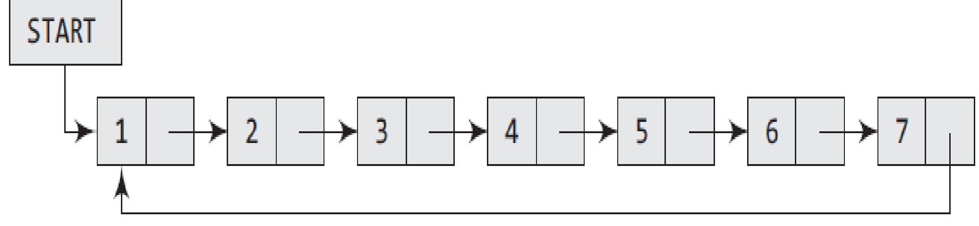
Introduction
In a circular linked list, the last node contains a pointer to the first node of the list.
We can have a circular singly linked list as well as a circular doubly linked list.
While traversing a circular linked list, we can begin at any node and traverse the list in any direction, forward or backward, until we reach the same node where we started.
Thus, a circular linked list has no beginning and no ending.
Figure shows a circular linked list.
The only downside of a circular linked list is the complexity of iteration.
Note that there are no NULL values in the NEXT part of any of the nodes of list.

Slide 3
Introduction
Circular linked lists are widely used in operating systems for task maintenance.
We will now discuss an example where a circular linked list is used.
When we are surfing the Internet, we can use the Back button and the Forward button to move to the previous pages that we have already visited.
How is this done? The answer is simple.
A circular linked list is used to maintain the sequence of the Web pages visited.
Traversing this circular linked list either in forward or backward direction helps to revisit the pages again using Back and Forward buttons.
Actually, this is done using either the circular stack or the circular queue.

Slide 4
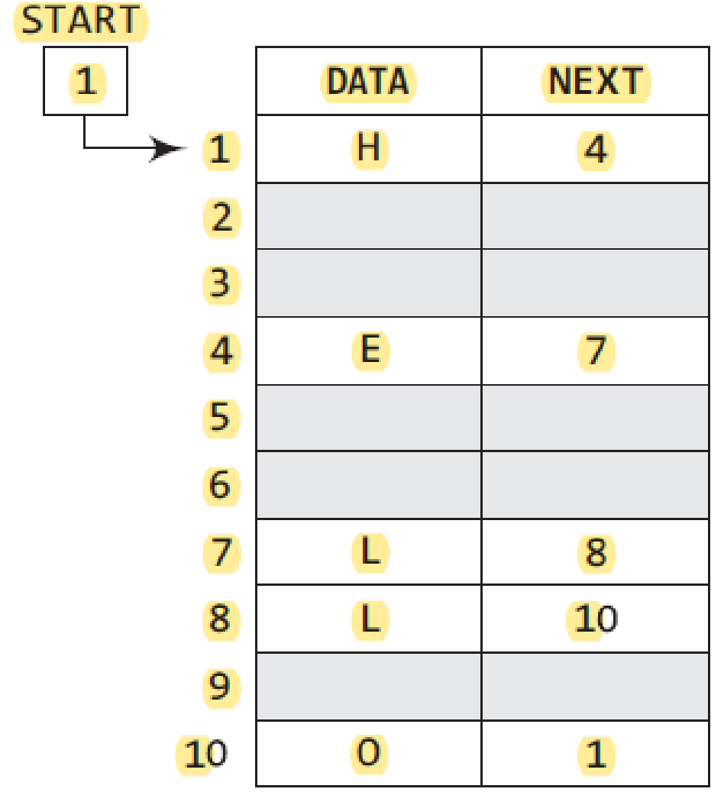
Introduction
We can traverse the list until we find the NEXT entry that contains the address of the first node of the list.
This denotes the end of the linked list, that is, the node that contains the address of the first node is actually the last node of the list.
When we traverse the DATA and NEXT in this manner, we will finally see that the linked list in Fig stores characters that when put together form the word HELLO.

Slide 5
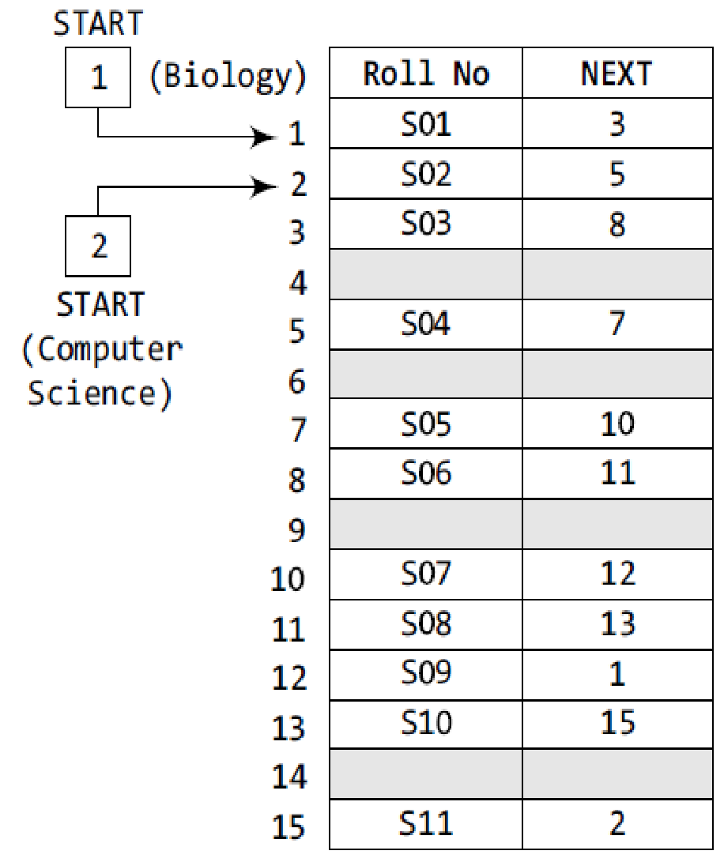
Introduction
Two different linked lists are simultaneously maintained in the memory.
There is no ambiguity in traversing through the list because each list maintains a separate START pointer which gives the address of the first node of the respective linked list.
The remaining nodes are reached by looking at the value stored in NEXT.
By looking at the figure, we can conclude that the roll numbers of the students who have opted for Biology are S01, S03, S06, S08, S10, and S11.
Similarly, the roll numbers of the students who chose Computer Science are S02, S04, S05, S07, and S09.

Slide 6
Inserting a New Node in a Circular Linked List
How a new node is added into an already existing linked list.
We will take two cases and then see how insertion is done in each case.
Case 1: The new node is inserted at the beginning of the circular linked list.
Case 2: The new node is inserted at the end of the circular linked list.

Slide 7
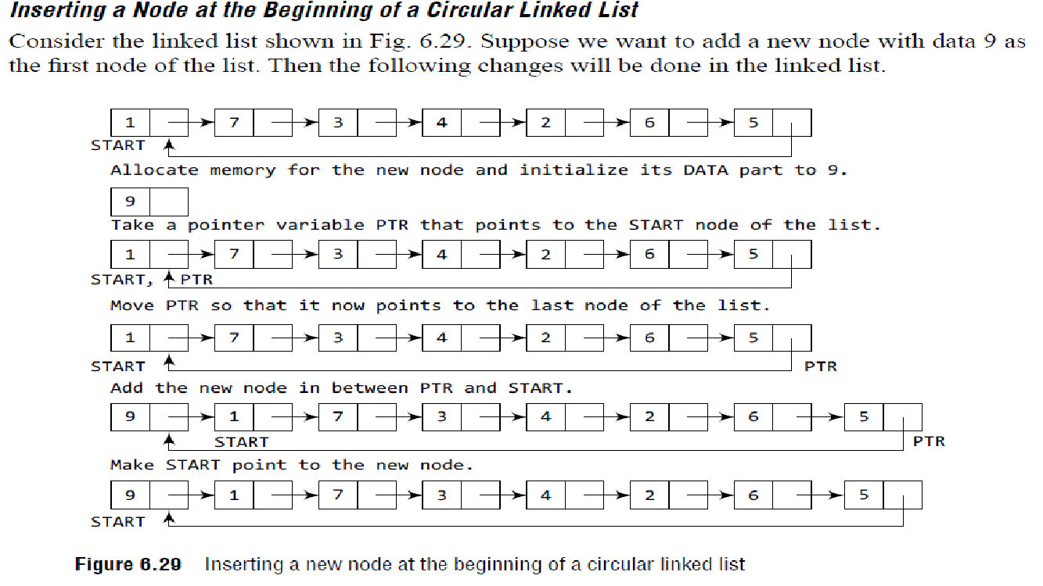

Slide 8
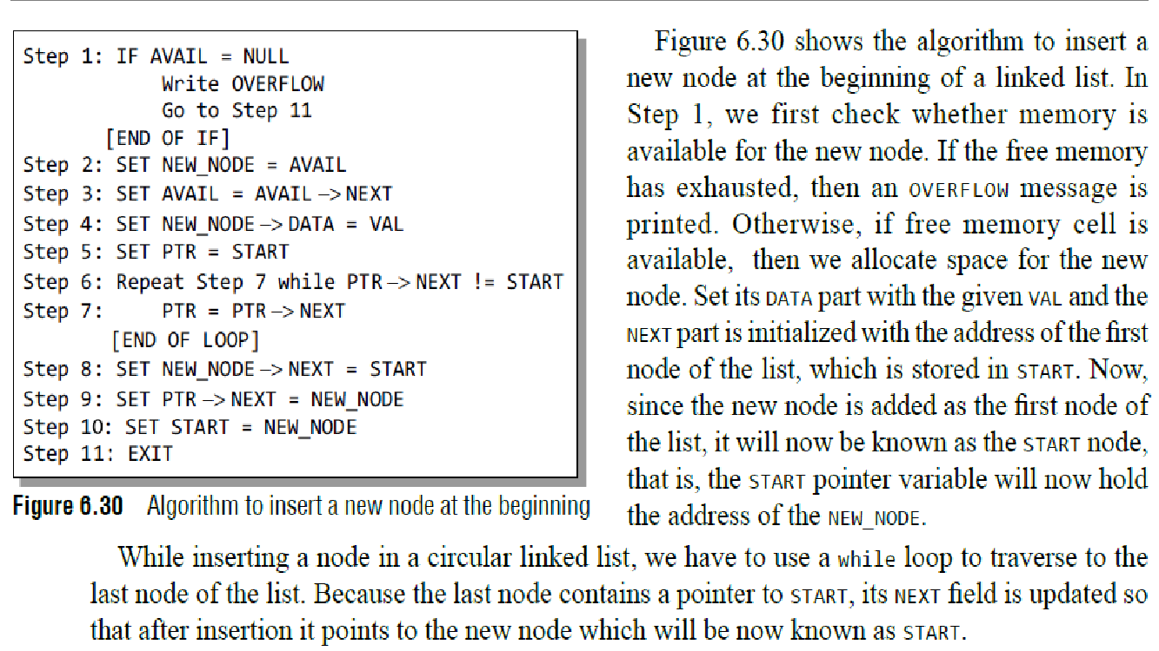

Slide 9
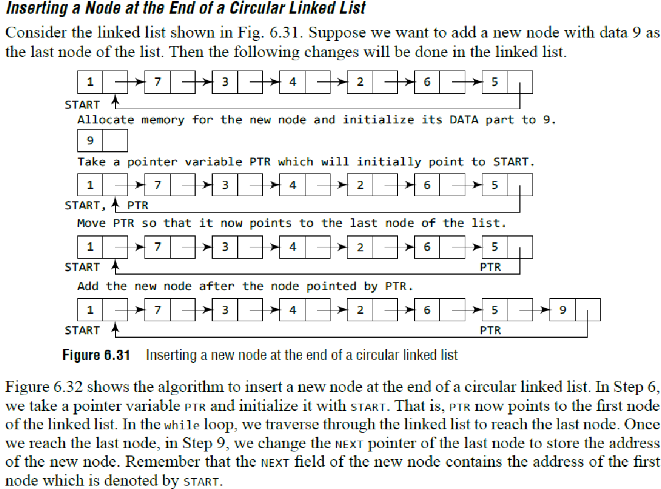
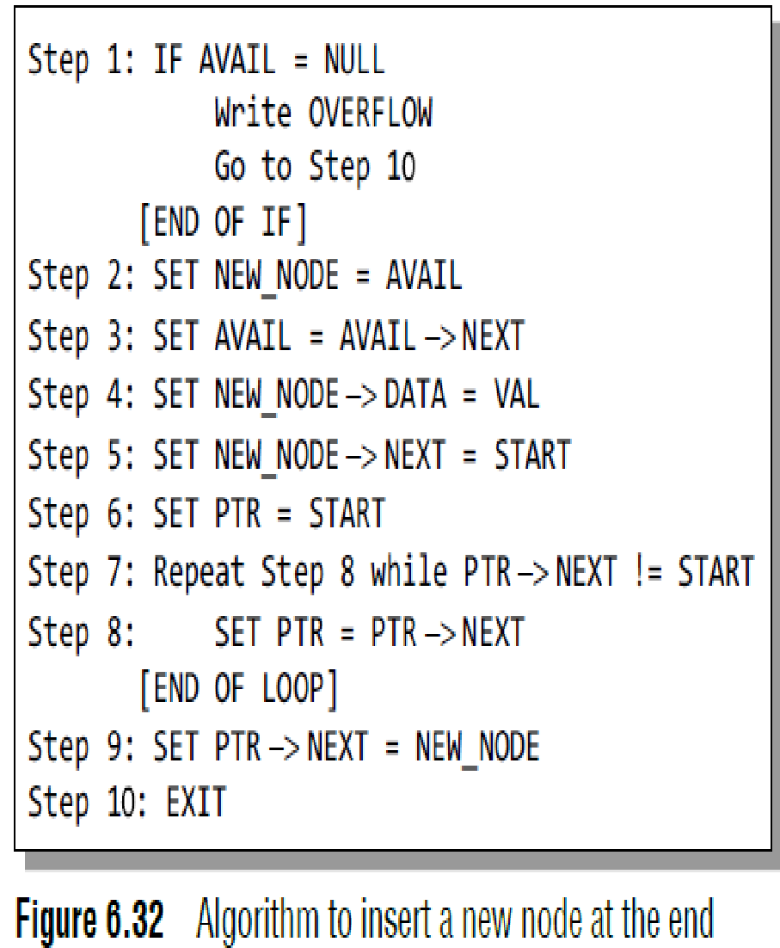

Slide 10
Deleting a Node from a Circular Linked List
How a node is deleted from an already existing circular linked list.
We will take two cases and then see how deletion is done in each case.
Rest of the cases are same as that given for linked lists.
Case 1: The first node is deleted.
Case 2: The last node is deleted.

Slide 11
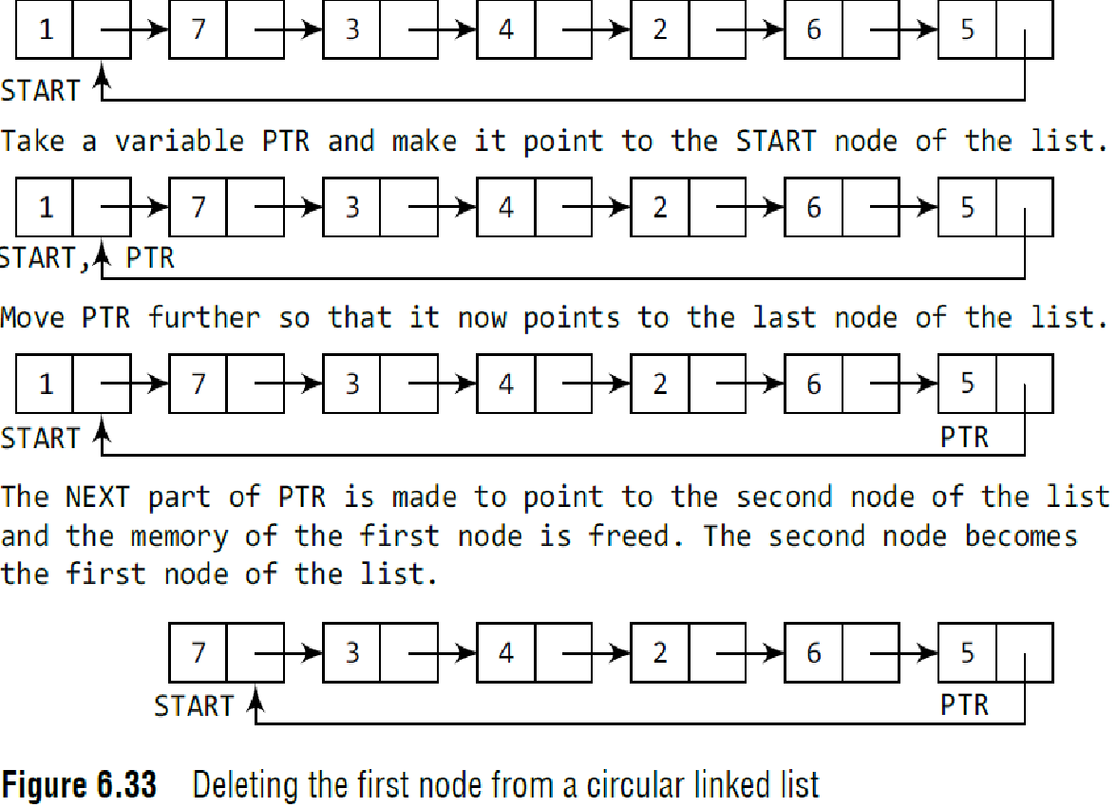
Deleting the First Node from a Circular Linked List
Consider the circular linked list shown in Fig. 6.33.
When we want to delete a node from the beginning of the list, then the following changes will be done in the linked list.

Slide 12
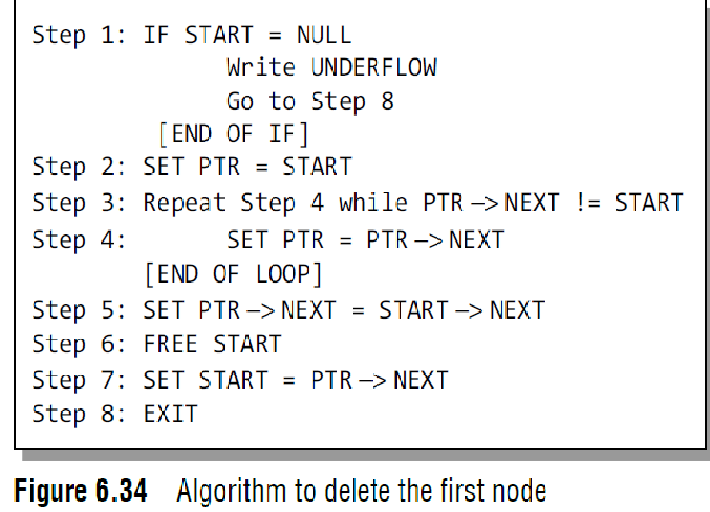
Deleting the First Node from a Circular Linked List
Figure 6.34 shows the algorithm to delete the first node from a circular linked list.
In Step 1 of the algorithm, we check if the linked list exists or not.
If START = NULL, then it signifies that there are no nodes in the list and the control is transferred to the last statement of the algorithm.
However, if there are nodes in the linked list, then we use a pointer variable PTR which will be used to traverse the list to ultimately reach the last node.
In Step 5, we change the next pointer of the last node to point to the second node of the circular linked list.
In Step 6, the memory occupied by the first node is freed.
Finally, in Step 7, the second node now becomes the first node of the list and its address is stored in the pointer variable START.

Slide 13
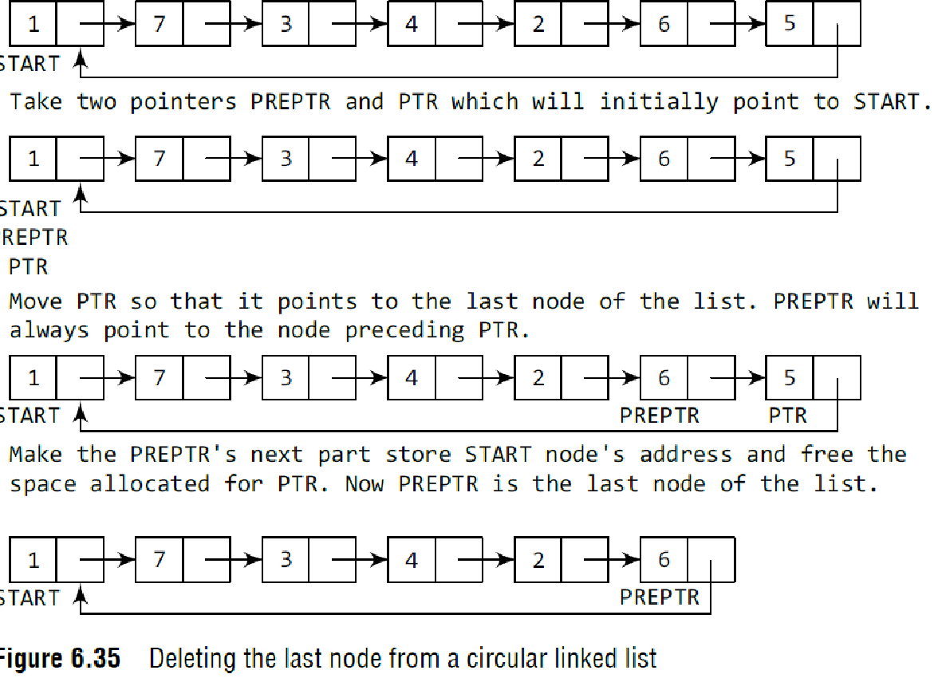
Deleting the Last Node from a Circular Linked List
Consider the circular linked list shown in Fig. 6.35.
Suppose we want to delete the last node from the linked list, then the following changes will be done in the linked list.

Slide 14
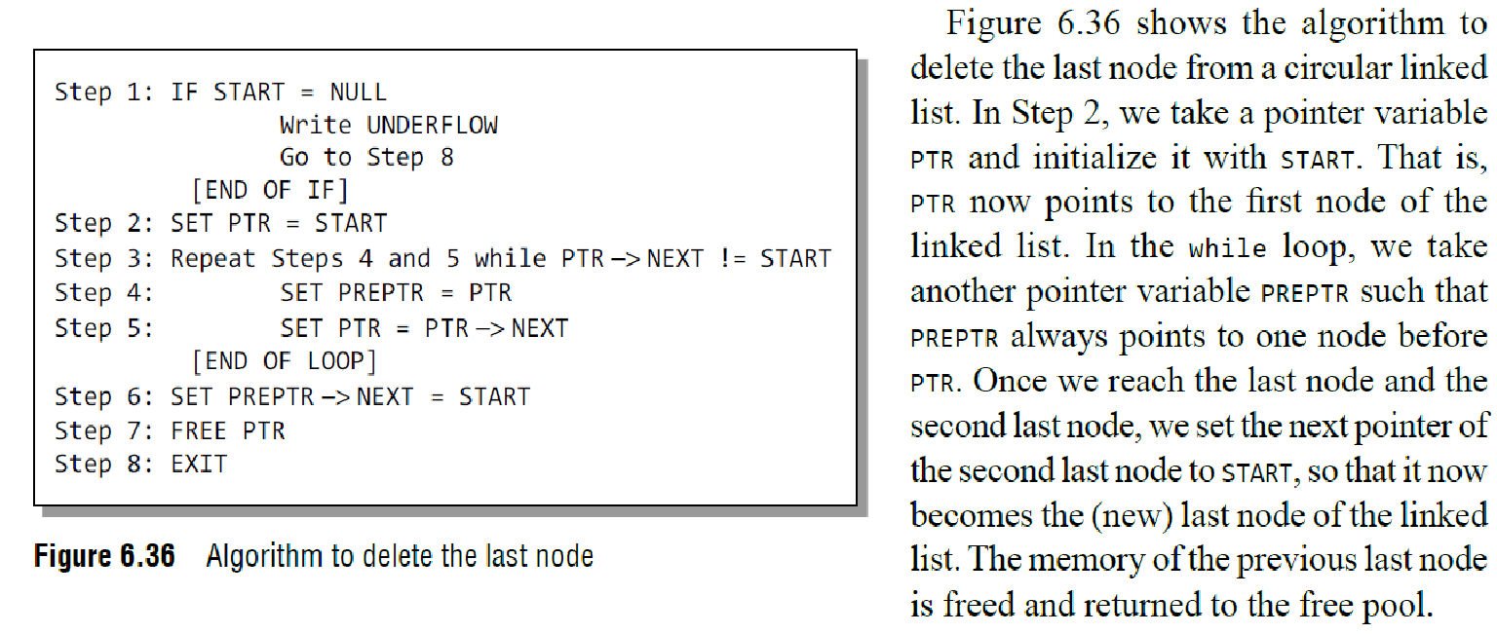
Deleting the Last Node from a Circular Linked List

Slide 15
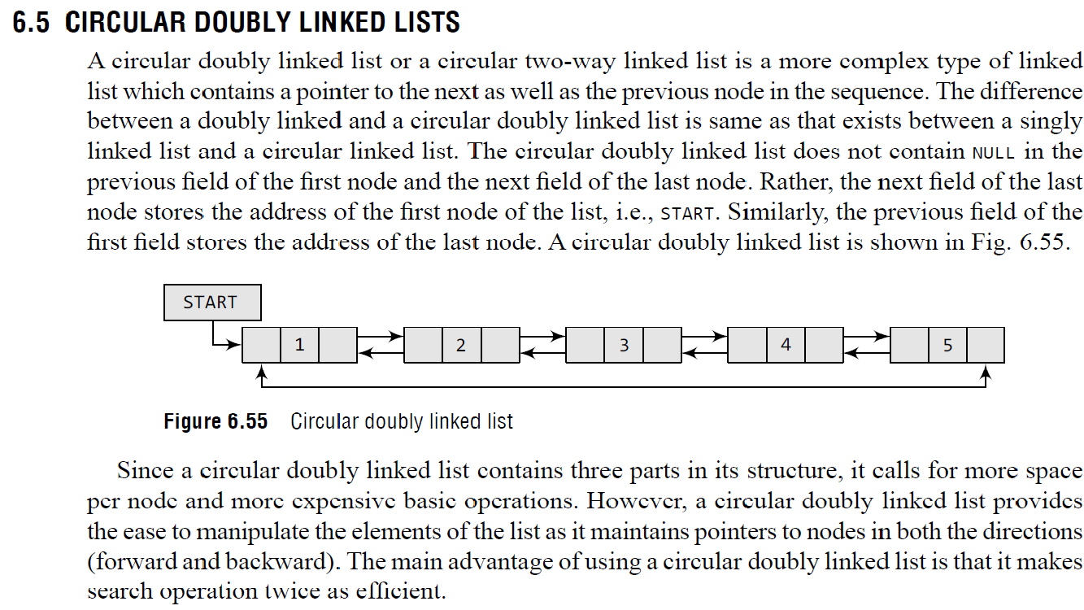

Slide 16
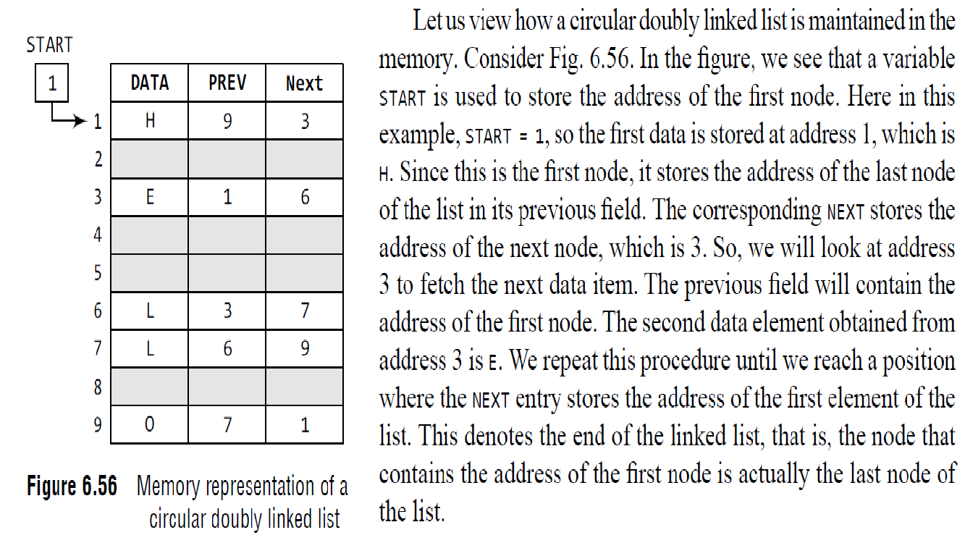

Slide 17
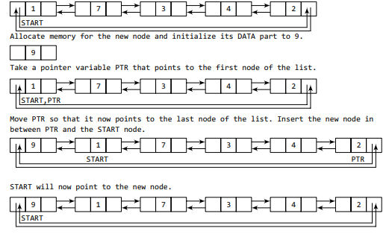
Inserting a Node at the Beginning of a Circular Doubly Linked List
Consider the circular doubly linked list shown in Fig.
Suppose we want to add a new node with data 9 as the first node of the list.
Then, the following changes will be done in the linked list.

Slide 18
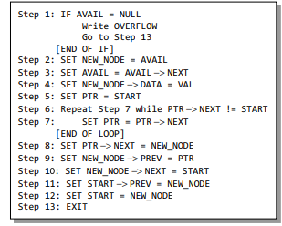
Inserting a Node at the Beginning of a Circular Doubly Linked List
Figure shows the algorithm to insert a new node at the beginning of a circular doubly linked list.
In Step 1, we first check whether memory is available for the new node.
If the free memory has exhausted, then an OVERFLOW message is printed.
Otherwise, we allocate space for the new node.
Set its data part with the given VAL and its next part is initialized with the address of the first node of the list, which is stored in START.
Now since the new node is added as the first node of the list, it will now be known as the START node, that is, the START pointer variable will now hold the address of NEW_NODE.
Since it is a circular doubly linked list, the PREV field of the NEW_NODE is set to contain the address of the last node.

Slide 19
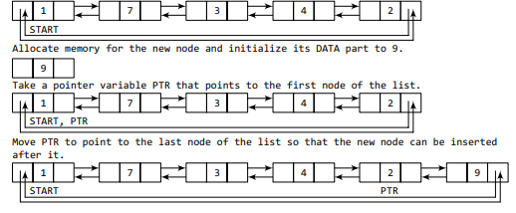
Inserting a Node at the End of a Circular Doubly Linked List
Suppose we want to add a new node with data 9 as the last node of the list.
Then the following changes will be done in the linked list.

Slide 20
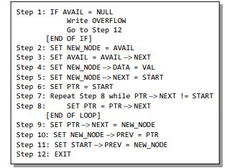
Inserting a Node at the End of a Circular Doubly Linked List
In Step 6, we take a pointer variable PTR and initialize it with START.
PTR now points to the first node of the linked list.
In the while loop, we traverse through the linked list to reach the last node.
Once we reach the last node, in Step 9, we change the NEXT pointer of the last node to store the address of the new node.
The PREV field of the NEW_NODE will be set so that it points to the node pointed by PTR (now the second last node of the list).

Slide 21
Deleting a Node from a Circular Doubly Linked List
How a node is deleted from an already existing circular doubly linked list.
We will take two cases and then see how deletion is done in each case.
Rest of the cases are same as that given for doubly linked lists.
Case 1: The first node is deleted.
Case 2: The last node is deleted.

Slide 22
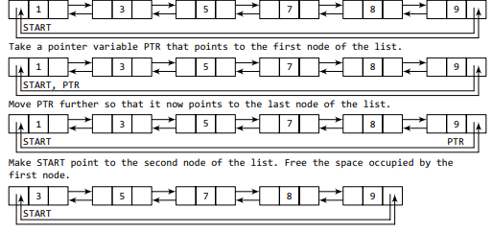
Deleting the First Node from a Circular Doubly Linked List
Consider the circular doubly linked list shown in Fig.
When we want to delete a node from the beginning of the list, then the following changes will be done in the linked list.

Slide 23
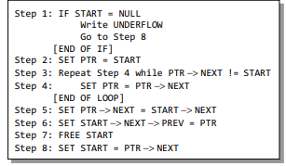
Deleting the First Node from a Circular Doubly Linked List
Figure shows the algorithm to delete the first node from a circular doubly linked list.
In Step 1 of the algorithm, we check if the linked list exists or not.
If START = NULL, then it signifies that there are no nodes in the list and the control is transferred to the last statement of the algorithm.
However, if there are nodes in the linked list, then we use a pointer variable PTR that is set to point to the first node of the list.
For this, we initialize PTR with START that stores the address of the first node of the list.
The while loop traverses through the list to reach the last node.
Once we reach the last node, the NEXT pointer of PTR is set to contain the address of the node that succeeds START.
Finally, START is made to point to the next node in the sequence and the memory occupied by the first node of the list is freed and returned to the free pool.

Slide 24
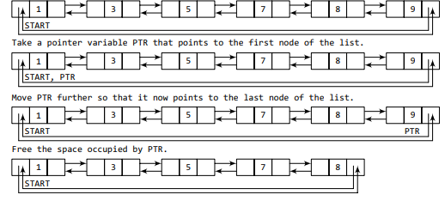
Deleting the Last Node from a Circular Doubly Linked List
Consider the circular doubly linked list shown in Fig.
Suppose we want to delete the last node from the linked list, then the following changes will be done in the linked list.

Slide 25
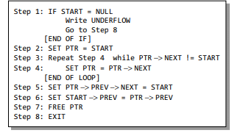
Deleting the Last Node from a Circular Doubly Linked List
Figure shows the algorithm to delete the last node from a circular doubly linked list.
In Step 2, we take a pointer variable PTR and initialize it with START.
That is, PTR now points to the first node of the linked list.
The while loop traverses through the list to reach the last node.
Once we reach the last node, we can also access the second last node by taking its address from the PREV field of the last node.
To delete the last node, we simply have to set the next field of the second last node to contain the address of START, so that it now becomes the (new) last node of the linked list.
The memory of the previous last node is freed and returned to the free pool.

